Slide 1
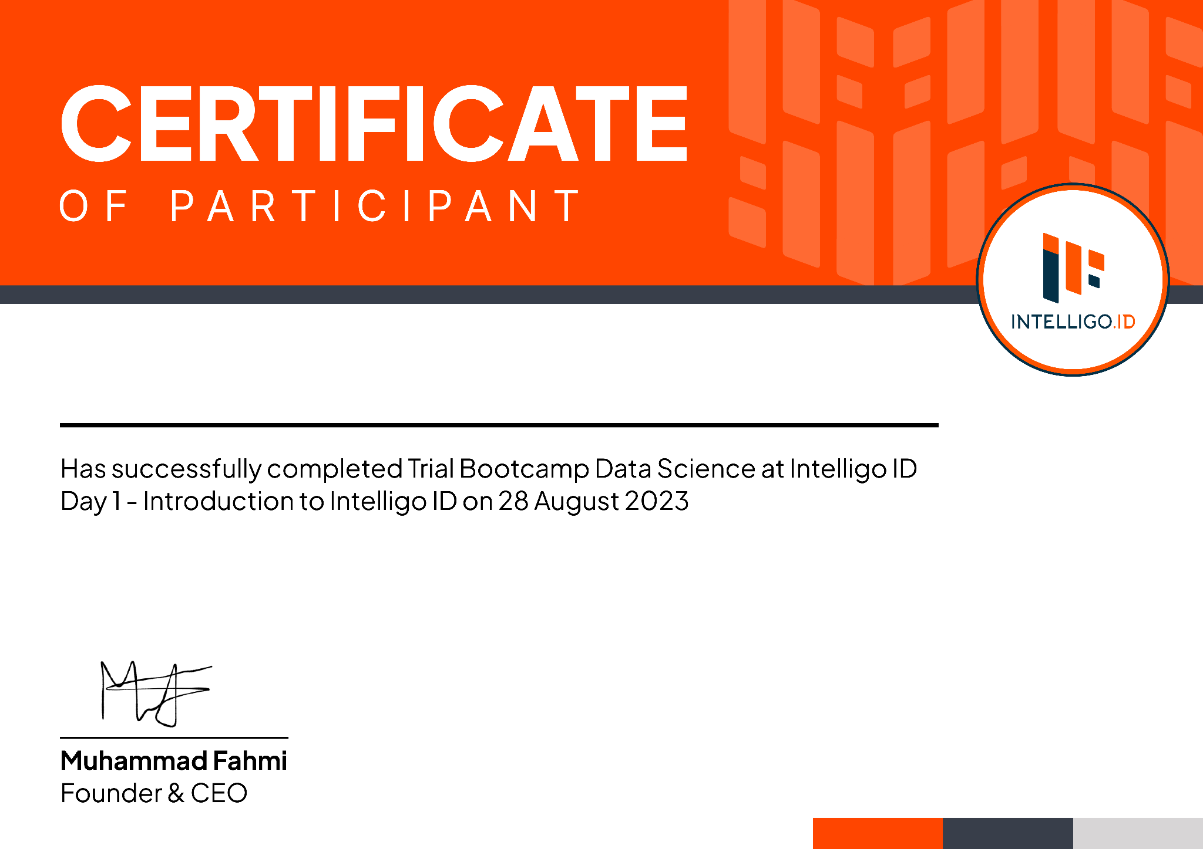

{{NAMA}}
Has Successfully Participated in
{{JUDUL}}
held from {{PELAKSANAAN}}
Muhammad Fahmi
Head of Learning
Certificate ID : {{id}}

